Slide 1
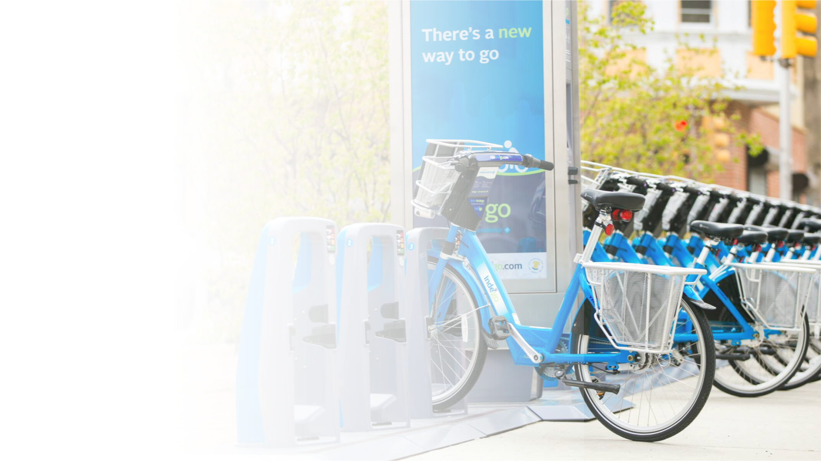


Cyclistic Customer Analysis
Stefanus Yudi Irwan – September 11th 2022
Data Analytics Portfolio
23th August 2022
Notes:
Hello All, today I will present to you my portfolio about Cyclistic Customer Analysis, I made this in order to finish my Google Data Analytics Professional Certificate.

Slide 2

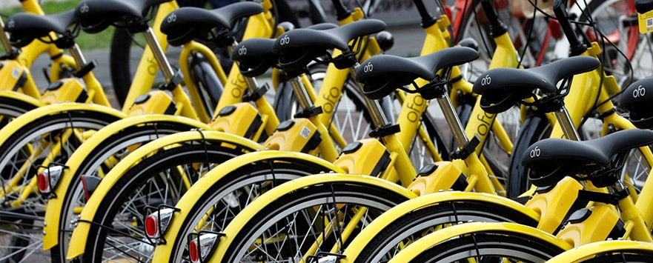
About Cyclistic
Cyclistic is a bike-share program that features more than 5,800 bicycles and 692 docking stations in Chicago. The bikes can be unlocked from one station and returned to any other station in the system anytime.
Cyclistic apply flexible pricing plans : single-ride passes, full-day passes, and annual memberships.
Single-Ride Passes
CASUAL RIDER
Full-Day Passes
Annual Memberships
CYCLISTIC MEMBER
Data Analytics Portfolio
2
Notes:
Let’s talk about cyclistic.
Cyclistic is a bike share program in Chicago, where we can share the bike across the city.
Cyclistic apply flexible pricing plans.
There are casual riders, consumer who pay per ride or per day,
and cyclistic member consumer who paid per year.

Slide 3




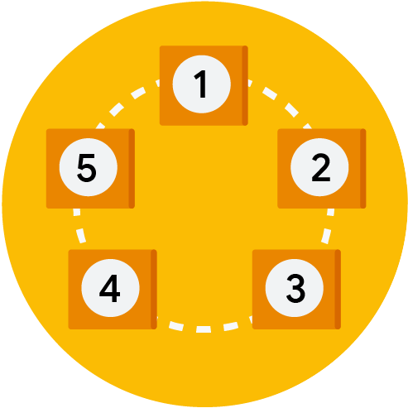







ASK
Scope of Work
PREPARE
Raw Data
Outline
PROCESS
Clean Data
Steps
Output
ANALYZE
EDA
SHARE
Dashboard
ACT
Marketing Strategy
Data Analytics Portfolio
3
Notes:
There will be several steps within the Data Analysis Phase,
the first is ASK for creating the scope of work,
then PREPARE to find the raw data,
next is PROCESS to transform the raw data into the clean data,
then ANALYZE to extract insight through Exploratory Data Analysis,
and then SHARE the result of the analysis through a dashboard,
and the last is ACT where the team take action through marketing strategy

Slide 4


ASK
1
Data Analytics Portfolio
Notes:
Let’s go through the first steps in Data Analysis Process, ASK

Slide 5



Project Stakeholders
1.
CYCLISTIC Executive Team
Marketing program recommendation approval
2.
CYCLISTIC Director of Marketing
Responsible for bike-share program campaigns and initiatives development
Data Analytics Portfolio
5
Notes:
Within this project, the first stakeholders are CYCLISTIC executive team, who approve the marketing program,
and the second is director of marketing, who responsible for this program campaign and development

Slide 6



Problems
Company want more profit to expand the business
Annual members are much more profitable than casual riders
Annual members will be the key to company’s future growth.
Data Analytics Portfolio
6
Notes:
The Problem is, this company need profit to expand the business,
finance analyst tell us data analyst team, that annual member are more profitable,
and then the stakeholder believes that by growing the amount of cyclistic member company will grow more

Slide 7

Project Goal
“Increase the number of Annual members by at least 25% within the Q1 of the year, through conversion from casual rider to annual member”
Business Task
“Analyze CYCLISTIC historical bike trip data to identify the behavior of the casual rider and annual member to enhance the number of annual members through marketing strategies to increase profit and grow the company.”
Scope Of Work Document
Data Analytics Portfolio
https://unsplash.com/photos/Blu06wJQ4Cs?utm_source=unsplash&utm_medium=referral&utm_content=creditShareLink
7
Notes:
So, this project goal is to increase the number of annual members by at least 25% for this year’s Q1,
through conversion from casual rider into annual member.
And the Business Task for the data analysis team,
is to analyze the historical bike trip data to identify the behavior of annual members and casual riders.
I put the result of these steps on the Scope of work document that you can access through this presentation files.

Slide 8

PREPARE
2
Data Analytics Portfolio
Photo by Huseyn Kamaladdin: https://www.pexels.com/photo/brown-wooden-desk-with-rolling-chair-and-shelves-near-window-667838/
Notes:
Let’s going to the second steps of data analysis, PREPARE

Slide 9

Data Collection
Data Requirements.
Scope of Data.
Bike user time data
Bike user place data
Bike station data
Type of bike used
User payment type
One year of historical data from August 2021 till July 2022 was used for this analysis
Data Source.
Raw data was stored within this website. The data was provided by Google Data Analytics Professional Certificate. This is an open data under this license.
<a href="https://www.freepik.com/free-photo/businesspeople-working-finance-accounting-analyze-financial-graph-budget-planning-future-office-room_16068251.htm#page=3&query=big%20data&position=47&from_view=keyword">Image by our-team</a> on Freepik
Data Analytics Portfolio
9
Notes:
For the project purpose,
we need relevant bike data like user time, user place, station, type of bike, and user type.
I limit the data into one year historical data started from August 2021 till July 2022.
And fortunately google data analytics certificate program provide me with the relevant data for the project,
you can access the data and license through the link in the presentation

Slide 10



Raw Data Composition
Dataset Overview
1
Time Data
Started_Time
Ended_Time
1.
Raw Data comprises of 12 CSV files, represent each month bike-share historical data
2
Spatial Data
Start_latitude
Start_longitude
End_latitude
End_longitude
2.
Size of the raw data is 1,01 Giga-Byte
3
Category Data
Rideable_type
Payment_type
3.
Raw Data comprises of 5,901,463 rows, and 13 columns
4
Ride_id
Start_station_id
Start_station_name
End_station_id
End_station_name
ID Data
Raw Data
Data Analytics Portfolio
10
Notes:
The raw data is comprised of 12 CSV files, one file for a month, and the size is large enough like 1 gigabyte,
The data it is comprised of 13 columns and 5,9 million rows.
The 13 columns is comprises of Time data, Spatial Data, Category Data, and Identification data.
You can look at the raw data through this link.

Slide 11

3
PROCESS
Data Analytics Portfolio
Notes:
After we get the raw data lets clean it through the next step, PROCESS

Slide 12







Cleaning data was done by using Microsoft Excel
DATA CLEANING STEPS
Clean Data
Cleaning Log
1.
Import csv data to Microsoft excel
3.
Check data duplication
5.
Check spelling for category data
Adjust time data and spatial data format
Check blank value
Create column “started days name” and “duration”
2.
4.
6.
Data Analytics Portfolio
12
Notes:
I use Microsoft Excel to clean up the data for analysis purposes through these 6 steps.
First I import the CSV into Excel,
then I format the data, check for duplication, check for blank value, check spelling,
and then calculate extra data for the day’s name and duration.
You can access the clean data and cleaning log through this linkl

Slide 13

4
ANALYZE
Data Analytics Portfolio
Notes:
Here is the most interesting part, ANALYZE

Slide 14
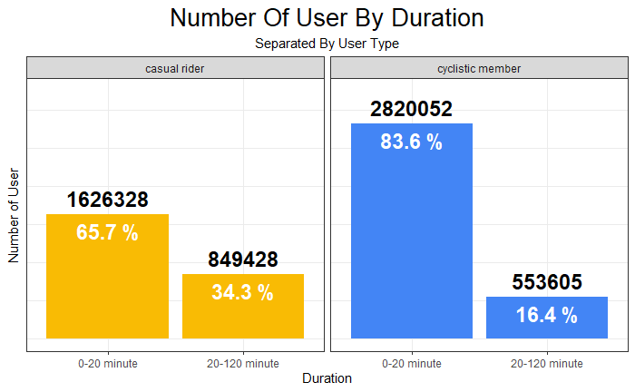
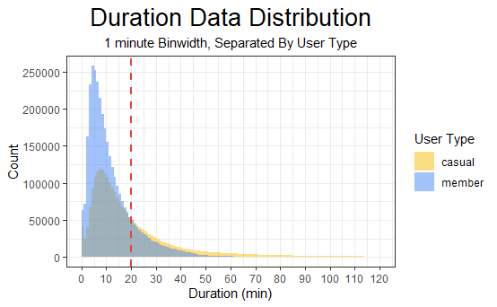
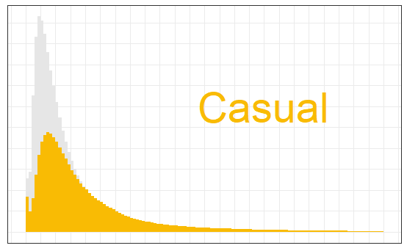
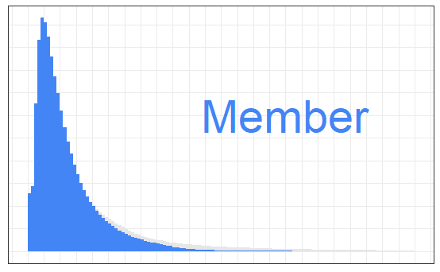

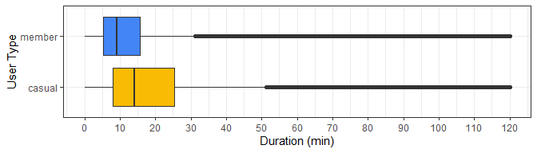
Analysis By Duration
Insight.
casual rider tend to use the bike longer than cyclistic member
cyclistic member and casual rider most likely uses the bike within time 0-20 minutes.
more casual rider at time frame 20-120 minutes than cyclistic member
casual rider at time frame 0-20 minutes will be potential to be cyclistic member
Data Analytics Portfolio
14
Notes:
Analysis By Duration, show us that cyclistic member and casual rider most likely use the bike within time 0-20 minute,
and the casual rider tends to use the bike longer than cyclistic member.
So, the casual rider at duration 0-20 minute will be potential to be the cyclistic member

Slide 15
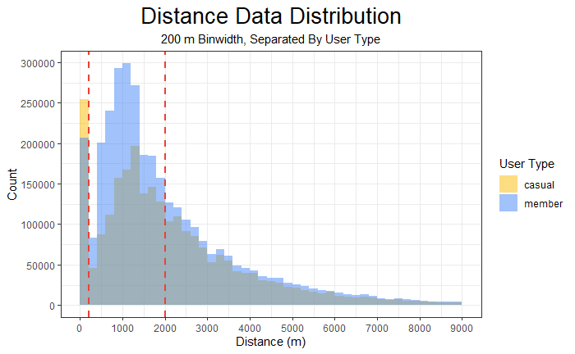
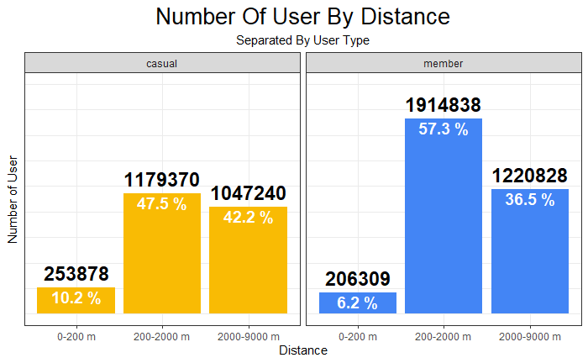
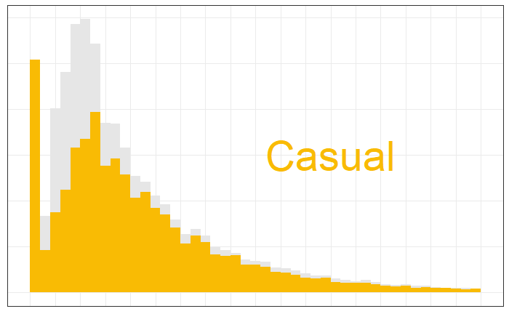
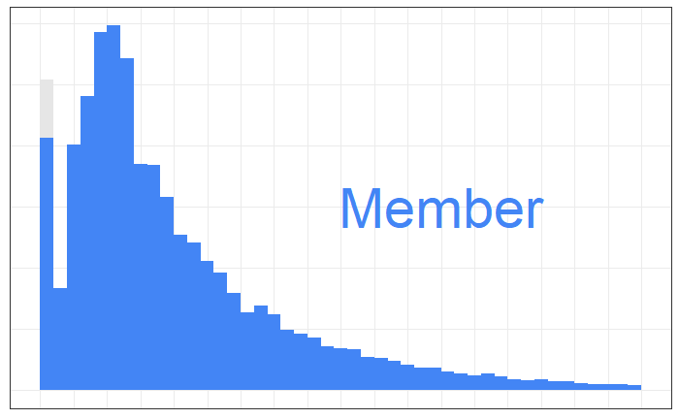
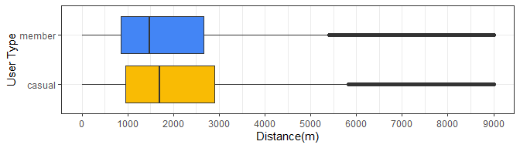
Analysis By Distance
Insight.
most cyclistic member use the bike for distance 200-2000 m.
more casual rider at distance 0-200 m than cyclistic member.
cyclistic member has more difference between distance 200-2000m and 2000-9000m than casual rider.
casual rider at distance 200-2000 m will be potential to be cyclistic member.
Data Analytics Portfolio
15
Notes:
Analysis by Distance show us
that most cyclistic members use the bike for distance 200 to 2000 m, and in the second place for distance 2000 to 9000 m.
Hence it is also good for casual riders with distance 200 to 2000 m and 2000 to 9000 m to be the cyclistic member.

Slide 16
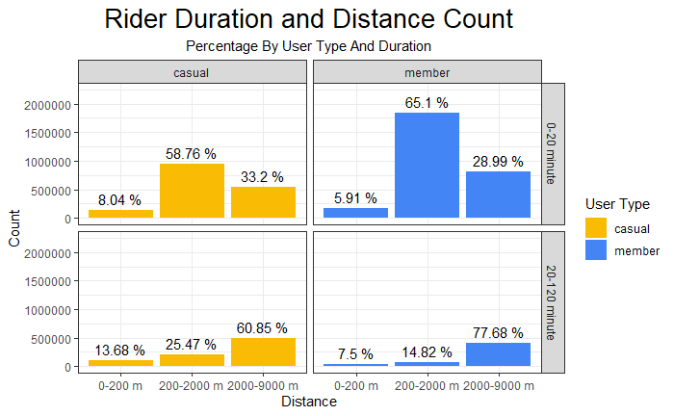
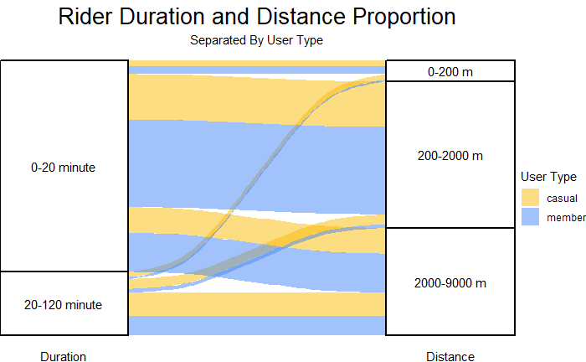
Analysis By Duration and Distance
Cyclistic member most likely use the bike for duration 0-20 minute and distance 200-9000m, also for duration 20-120 minute and distance 2000-9000 m
Insight.
The difference between the most dominant count and the rest of the count in every group is larger at cyclistic member than at casual rider
Casual rider with duration 0-20 minute and distance 200-9000 m or with duration 20-120 minute and distance 2000-9000 m will be a good candidate to be cyclistic member
Data Analytics Portfolio
16
Notes:
Combine analysis between duration and distance shows us,
that Cyclistic members most likely use the bike for a duration of 0 to 20 minutes and a distance of 200 to 9000m,
and also for a duration of 20 to 120 minutes and a distance of 2000 to 9000 m.
Hence the casual rider with the same distance and duration also can be a good potential to be cyclistic member

Slide 17
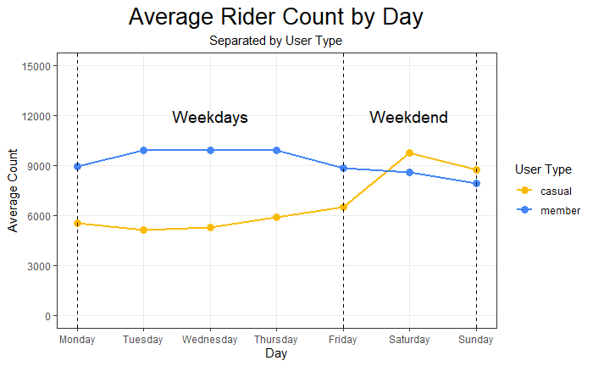
Analysis By Days
Insight.
Average cyclistic member per day is stable at weekdays and going down at weekend.
Average casual rider per day raise at the weekend.
Casual rider at weekdays will be good potential to be cyclistic member
Weekend is a good time for cyclistic member promotion activity because there are more casual rider
Data Analytics Portfolio
17
Notes:
Analysis by Days shows us
that amount of cyclistic member at weekdays tend to be stable,
and on the weekend there are more casual rider rather than cyclistic member.
So the weekend is a good time for cyclistic member promotion activity because there are more casual rider

Slide 18
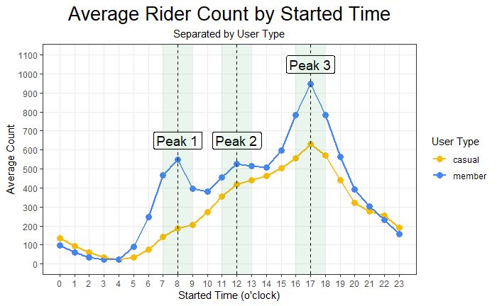
Analysis By Started Time
Insight.
There are 3 peak time for cyclistic member, 8, 12, and 17 o’clock. This is might be the time when commuting to work, lunch break, and commuting to home.
Casual rider only has obvious peak at 17 o’clock.
Casual rider at time 7-9, 11-13, and 16 – 18 o’clock could be good potential candidate to be cyclistic member.
Data Analytics Portfolio
18
Notes:
Analysis by Started time show us
that there is 3 peak time for cyclistic member, 8, 12, and 17 o’clock,
This might be the time when commuting to work, having lunch break, and commuting home.
Casual riders at those peak times 8, 12, and 17 o’clock could be a good potential candidates to be cyclistic members.

Slide 19
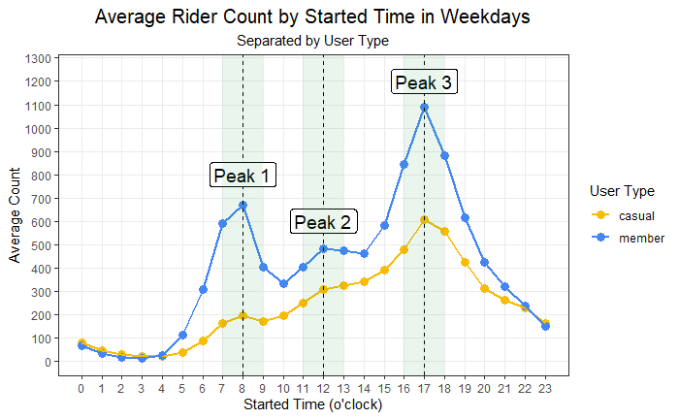
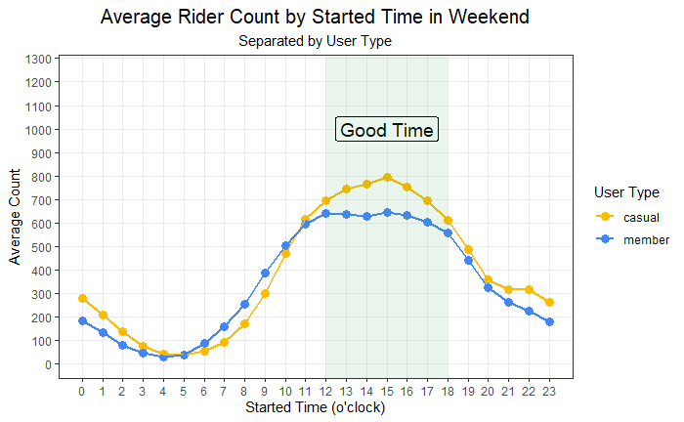
Analysis By Days and Time
in weekdays there are still 3 peak time for cyclistic member, 8, 12, and 17 o’clock.
casual member at weekdays now has 2 obvious peak at 8 and 17 o’clock.
more casual rider at weekend 12 – 18 o’clock (afternoon) this could be a good time to promote the cyclistic member conversion program
casual rider at time 7-9, 11-13, and 16 – 18 o’clock at weekdays could be good potential candidate to be cyclistic member.
Insight.
Data Analytics Portfolio
19
Notes:
Combine analysis by Days and Time show us
that the trend per hour for weekend and weekdays is not the same,
there are always more cyclistic member at working hour in weekdays
and there is also more casual rider in the weekend afternoon.
You can target the casual rider around 8, 12, and 17 o’clock on weekdays.
And the good time for promotion is the weekend at 12 PM – 6 PM.

Slide 20
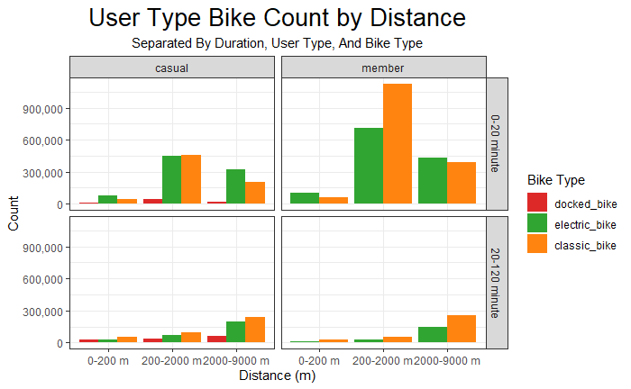
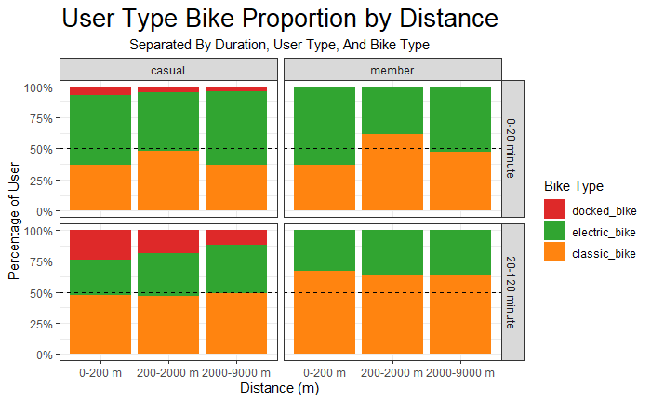
Analysis By Bike Type
Cyclistic members prefer to use a classic bike over an electric bike for distances 200-2000 m and duration 0-20 minutes, while casual riders are still 50:50 for classic bikes or electric bikes.
For distances 2000 – 9000 m and duration 0-20 minutes either cyclistic members or casual riders prefer an electric bike to a classic bike
There are no cyclistic members who used docked bikes, then there is no use to promote cyclistic members to docked bike users.
Casual rider with a short duration (0-20 minute) and medium to long distances (200-9000 m) who use the classic or electric bike is a good group to be cyclistic member
Insight.
Data Analytics Portfolio
20
Notes:
Bike type analysis show us that
classic bike become the most popular bike among cyclistic member,
and there are no docked bike for cyclistic member.
There is more cyclistic member use the classic bike for a duration of 0-20 minutes, and distance of 200-2000 m.
For distances, 2000 – 9000 m and duration 0-20 minutes either cyclistic members or casual riders prefer an electric bike to a classic bike

Slide 21
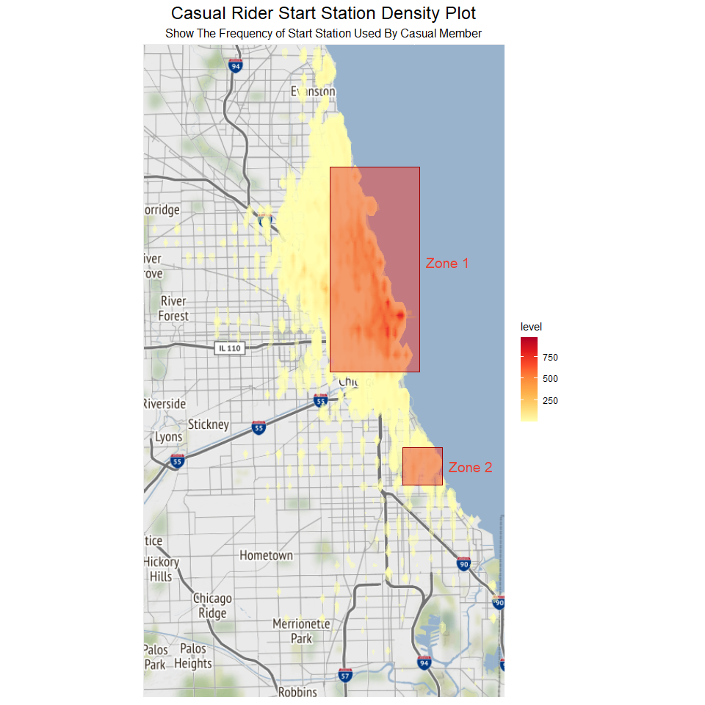

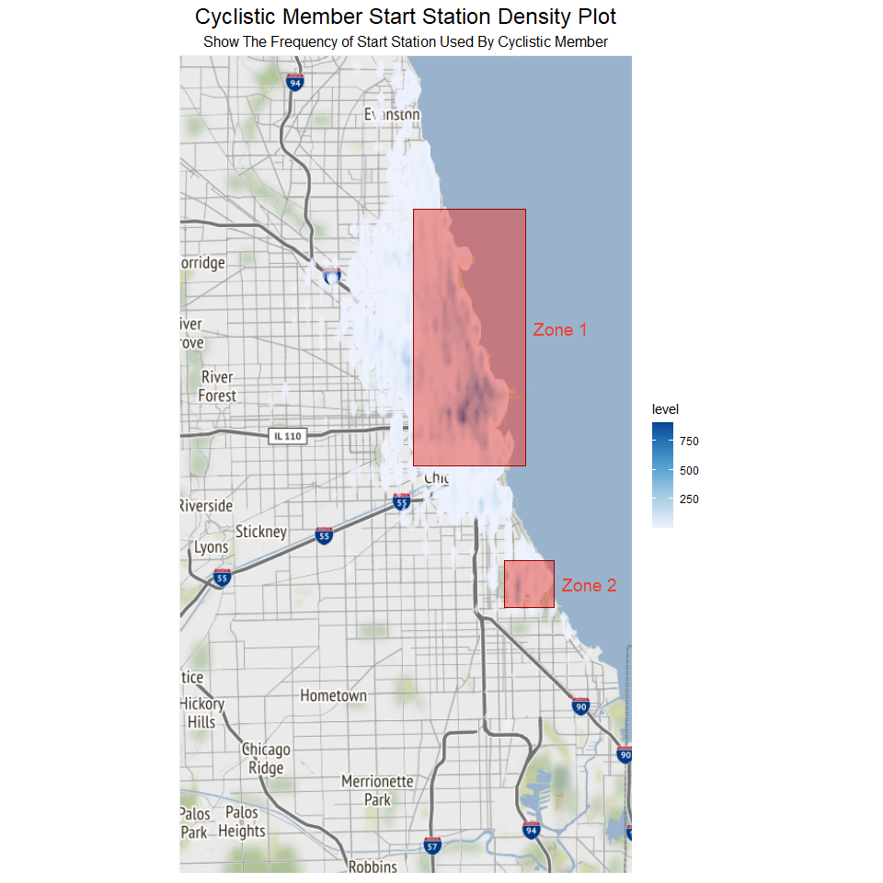

Analysis By Station
There are high number of bike user for casual rider and cyclistic member at Zone 1 and 2
Insight.
From this density map, we can infer that between casual riders and cyclistic members there are similarities of the station used
Zone 1 posses a good opportunity for cyclistic member marketing campaign
Data Analytics Portfolio
21
Notes:
Station analysis shows us
that the activity of cyclistic member and casual rider is concentrated in zone 1 and zone 2.
So there are similarities between the casual rider and cyclistic member that could make the casual rider suitable to become cyclistic member.

Slide 22
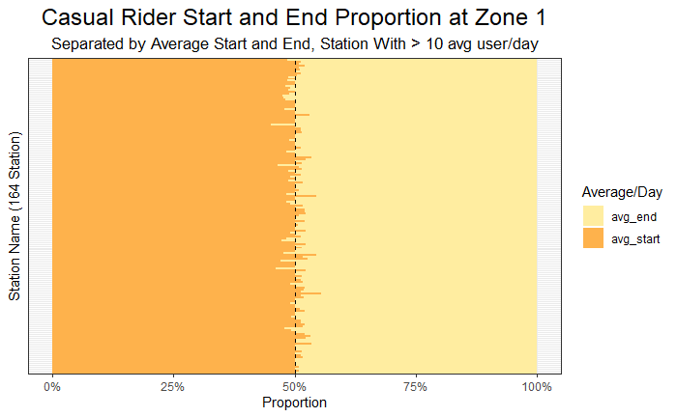
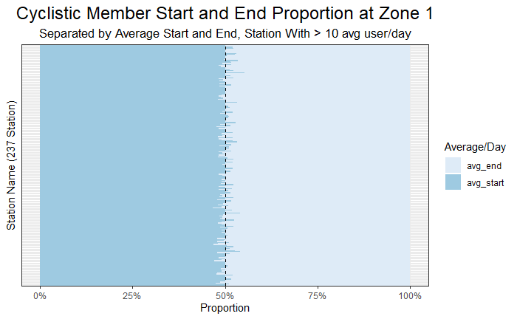
Analysis By Station
Station with an average user more than 10 user/day in zone 1, has a 50:50 proportion between the user who starts using the bike and the user who finish using the bike in the same station
In zone 1, behaviour of casual riders and cyclistic member was similar, they use the same station to start using the bike and end using the bike
Insight.
From this chart we could assume that there are fix number of casual rider and cyclistic member whom used the bikes for commuting in zone 1
Casual rider use less station compare to cyclistic member, 164 : 237 station, for commuting in zone 1
Data Analytics Portfolio
22
Notes:
This proportion analysis shows us
that in Zone 1 station with an average user of more than 10 user/day, has a 50:50 proportion
between the user who starts using the bike and the user who finish using the bike in the same station.
In zone 1, the proportion of casual riders and cyclistic members was similar,
this could be an indication that in this station casual riders also commute like cyclistic members.

Slide 23
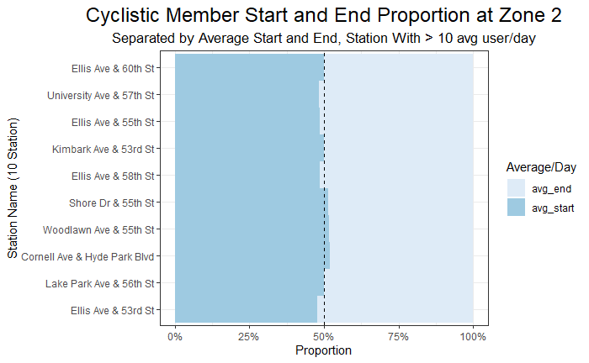
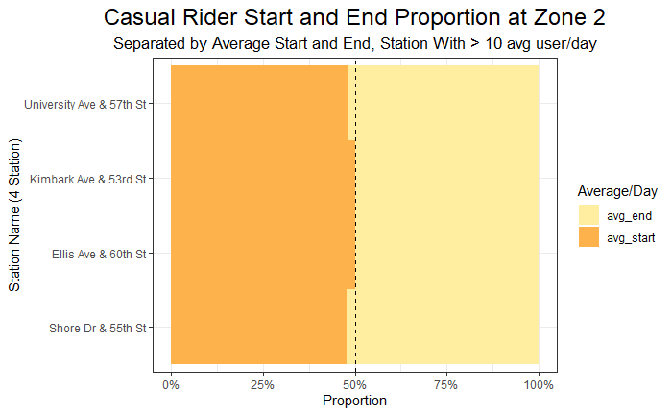
Analysis By Station
Station with an average user more than 10 user/day in zone 2, also has a 50:50 proportion between the user who starts using the bike and the user who finish using the bike in the same station
Insight.
In zone 2, behaviour of casual riders and cyclistic member was similar, they use the same station to start using the bike and end using the bike
Casual rider use less station compare to cyclistic member, 4:10 station, for commuting in zone 2
Data Analytics Portfolio
23
Notes:
This analysis in zone 2 also shows us the same pattern as the stations in zone 1,
the point is there is casual rider who uses the bike for commuting and this casual rider could be good potential to become a cyclistic member.

Slide 24
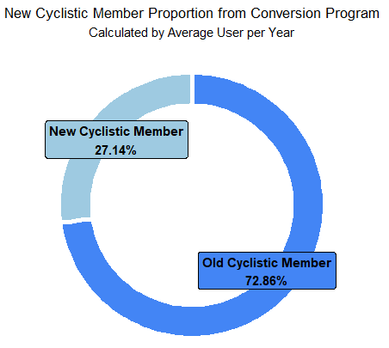
EDA
Analysis By Station
Station Target Zone 1 (160 Station) | Station Target Zone 2 (4 Station)
Stretter Dr & Grand Ave | University Ave & 57th St
DuSable Lake Shore Dr & Monroe | Kimbark Ave & 53rd St
Millenium Park | Ellis Ave & 60th St
Michigan Ave & Oak St | Shore Dr & 55th St
DuSable Lake Shore Dr & North Blvd
Shedd Aquarium
Theater on the Lake
Wells St & Concord Ln
…
For efficient marketing campaign, we could target 160 most visited station in zone 1 and 4 most visited station in zone 2 by commuted casual rider
Insight.
If we could target commuted casual rider at those station, We could get a new Cyclistic Member scheme comprises of 27,14% new member from casual rider and 72,86% Old Cyclistic Member. There are 37,3% increase in Cyclistic Member head count
Data Analytics Portfolio
24
Notes:
For efficient marketing campaign,
we could target 160 most visited stations in zone 1
and 4 most visited station in zone 2 by casual rider who commute.
If we could convert all the casual riders within this target station
the company will get 37,3% new cyclistic member,
and the composition of the cyclistic member could become 27,14% of new cyclistic member and 72,86% of old cyclistic members

Slide 25

SHARE
5
Photo by fauxels: https://www.pexels.com/photo/top-view-photo-of-people-near-wooden-table-3183150/
Data Analytics Portfolio
Notes:
After analysis was done we are ready to present the report through SHARE steps

Slide 26

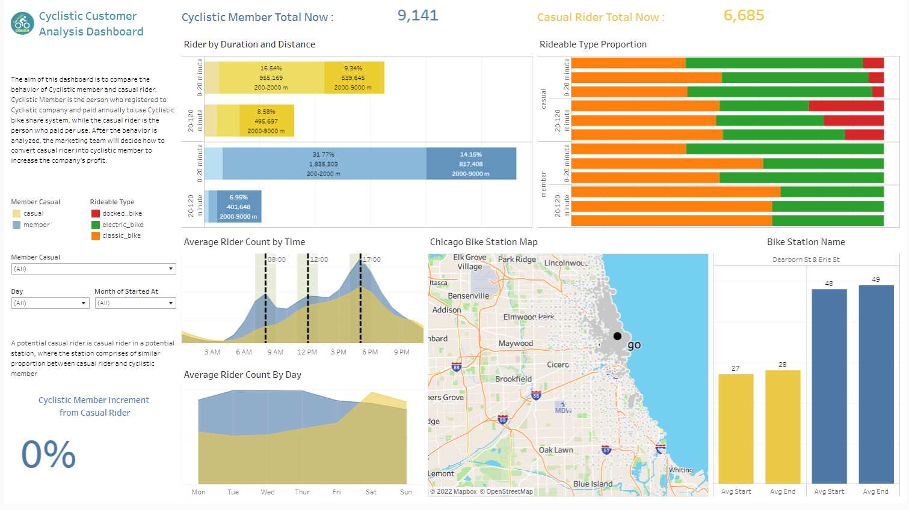
Tableau Dashboard
Data Analytics Portfolio
26
Notes:
Here
I already made the tableau dashboard that summaries the analysis we already conduct.
You can access the dashboard through this link in the presentation files.

Slide 27

ACT
6
Data Analytics Portfolio
https://www.behr.com/colorfullybehr/best-colors-for-home-offices/
Notes:
And here we already get into the final stage of data analysis process ACT

Slide 28
Marketing Strategy
1
To increase the number of cyclistic members by the end of this quarter, there are 160 most-used stations in zone 1, and 4 most-used stations in zone 2. If we could convert all of the cyclistic members who usually use the bike for commuting at those stations, there will be a 37.3% increase in the amount of cyclistic members.
Stations
2
Run promotion program on weekdays when people commute in the morning (7:00-9:00 A.M), in lunchtime (11:00 AM - 1:00 PM), or in the afternoon (4:00-6:00 PM). Conduct also the promotion program on weekends every 12:00-6:00 PM because at this time there is much casual rider in Chicago.
Time
Bike Type
3
Never target docked bike user, just target casual riders who use electric bikes or classic bikes. First target the classic bike users, then target the electric bike users.
Duration and Distance
4
Target the casual rider who use the bike with a duration of 0-20 minute and distance 200-2000 m first, then the second target is the group with a duration 0-20 minutes and distance of 2000-9000 m, and the last target is the group with a duration of 20-120 minutes and a distance of 2000-9000 m.
Data Analytics Portfolio
Data Analytics Portfolio
28
Notes:
This is some suggestion from the data analyst team regarding the marketing strategy to convert casual rider into cyclistic member.
First about station, team marketing can focus their work on the 160 most-used stations in zone 1
and 4 most-used stations in zone 2
to achive the increment till 37,3% of new cyclistic member.
Second about the time,
use commuting time to promote the program,
and also marketing team can use weekend when there is a lot of casual riders.
Third about bike type, never target docked bike user,
just target the casual rider who use classic bike first, and then electric bike.
Fourth is about Duration and distance,
station keeper could ask the casual rider where they want to go,
if the destination is taking duration of 0-20 minute and distance around 200-2000 m,
this is a good candidate for cyclistic member.

Slide 29







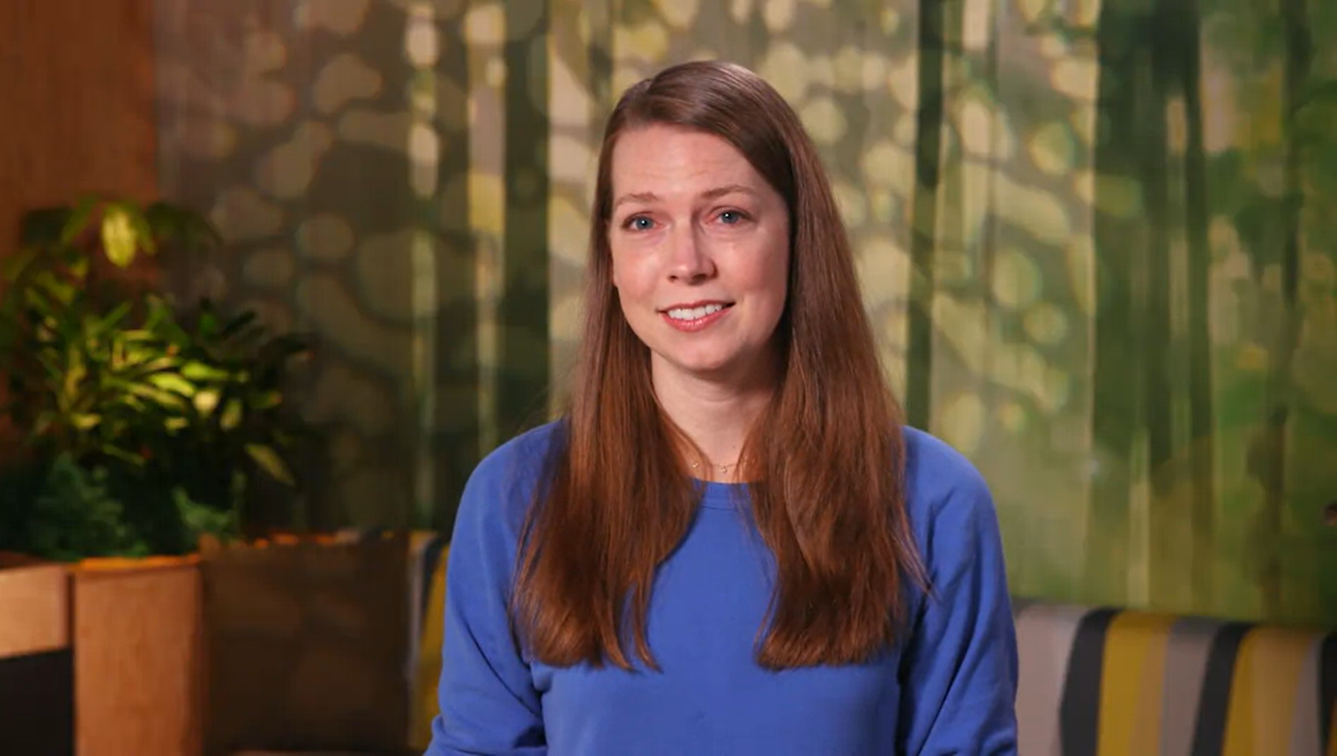
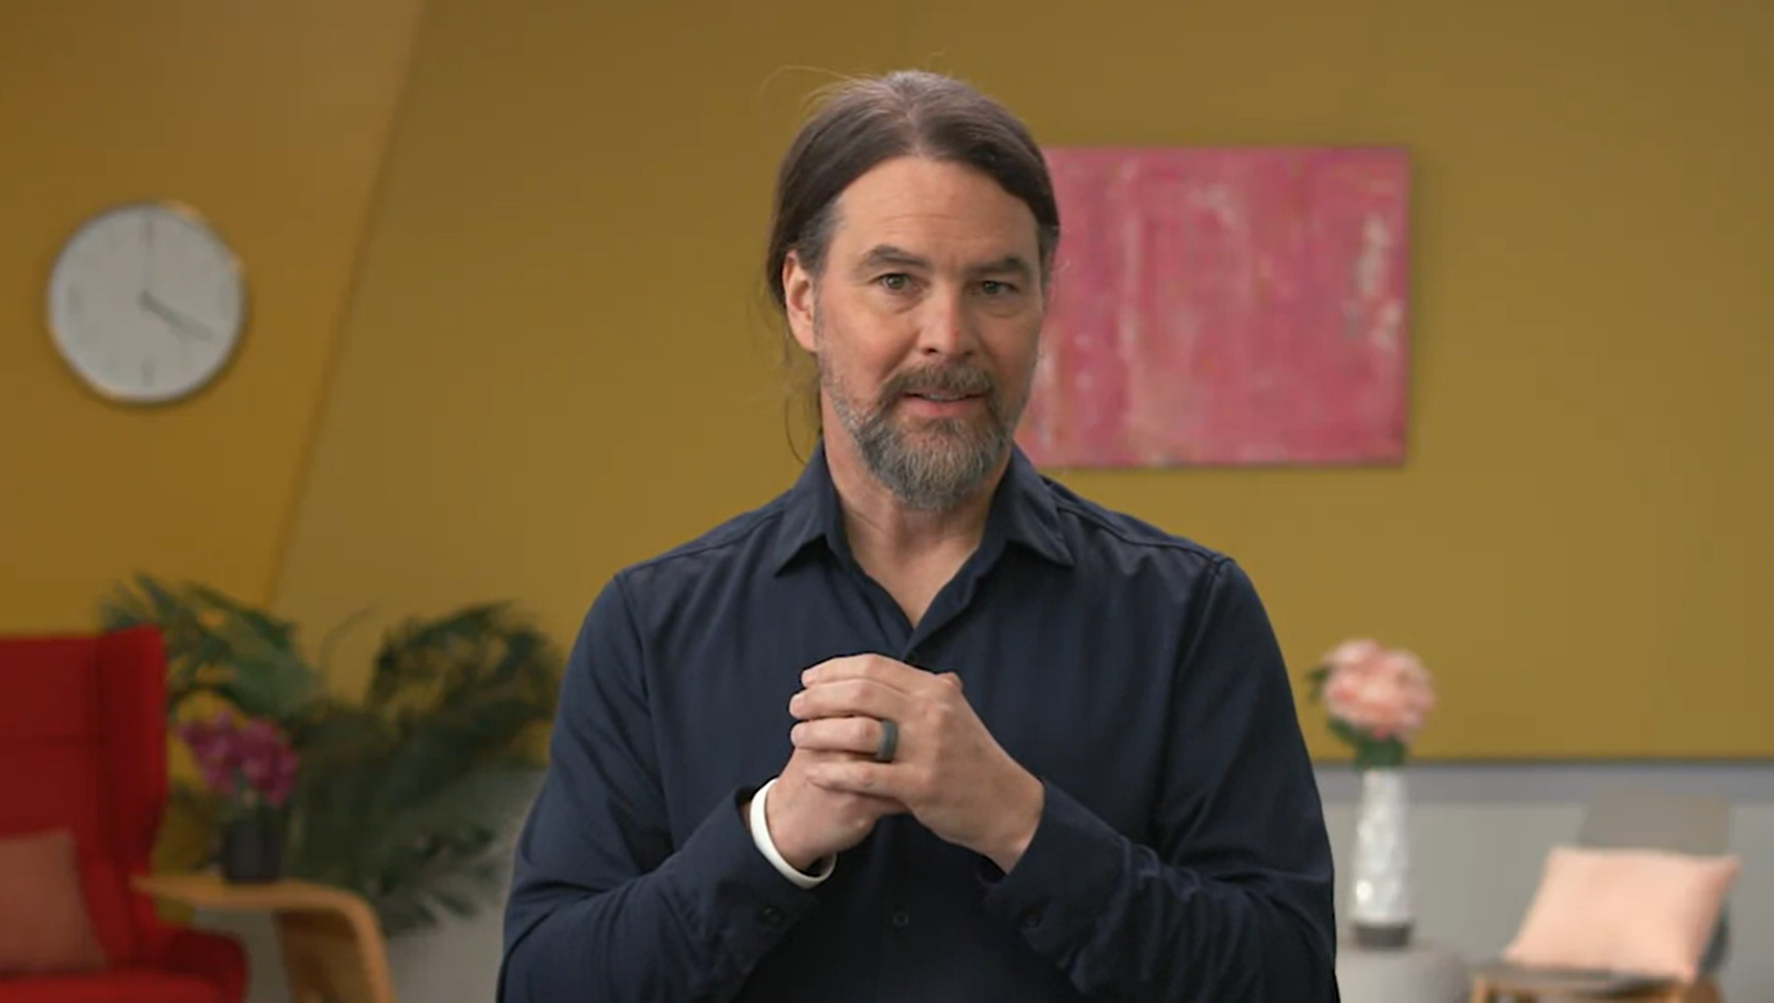

1. Foundation
3. Prepare
2. Ask
4. Process
Tony
Hallie
Program Manager
Analytical Lead
Ximena
Sally
Finance Data Analyst
Measurement & Analytical Lead
5. Analyze
7. R Programming
6. Share
8. Capstone Project
Ayanna
Carrie
Global Insight Manager
Research Manager
Rishie
Kevin
Director Of Analytics
Global Analytics Skills Curriculum
Data Analytics Portfolio
Notes:
Thank you so much for Google Data Analytics Certificate Program Team to teach me how properly I could become the Goggle Standard Data Analyst.

Slide 30



Slide 31


Slide 32








Project Article, Notebook, Repository, and Presentation
Reach me !
for discussion
Medium Article
Project-Notebook
My-Resume
Project-Repository
My Email
Kaggle-Repository
My Linked-In
YouTube Presentation
Data Analytics Portfolio

